Slide 1

PGB Session
June 18, 2026
Paul Wormeli, Chairman
NIEMOpen Project Governing Board

Slide 2
PROPOSED June 18 2026 AGENDA
Call to Order
Admin
  Call to Order
  Roll Call & Introductions
    Sponsor Appointed PGB Voting Members (Sponsors)
    PGB Expert Voting Members (TSCs) & Non-Voting Members (TSC Co-Chairs)
Approval of Meeting Agenda
2026 Initiatives
DMBOK
Community Survey
Sponsor/Volunteer Recruitment
Other Business
Next Meeting Schedule
Other Business/Discussion
Around-the-Horn – PGB Voting Member Comments/Questions
Adjourn
Reports
NIEMOpen Progress—Paul Wormeli
OASIS Update—Daniella Traveau
OASIS Standard ISO Path
NTAC Update –Brad Bolliger& Dr. Scott Renner
Toolkit status—Christina Medlin
NBAC Update – Thomas Krul & Paul Wormeli
--Forensics domain update-Ryan Triplett
Q1 2026 Financial Snapshot – Cathie Mayo (OASIS)

Slide 3



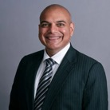




SPONSOR APPOINTED PGB VOTING MEMBERS
Mr. Paul Wormeli
IJIS Institute
Chair, NIEMOpen
Project Governing Board
Mark Dotson Senior Research Scientist, Georgia Tech Research Institute
Mr. Yogesh Chawla
Director, Software and Data Engineering
SEARCH
Ms. Christina Bapst-Stump
Science and Technology Directorate,
US Department of Homeland Security
Ms. April Mitchell FBI It Specialist and Technical Lead of Data Standards in the Criminal Justice Information Services (CJIS) Division
Mr. Tom Welch Director of Information Technology OHIO HIDTA –
Including Northern KY & Western PA
Mr. Jeff Butcher
Chief Software Architect,
Senzing, Inc.
Mr. Jose Plehn
CEO and Founder
BrightQuery

Slide 4





PGB EXPERT VOTING MEMBERS & NON-VOTING MEMBERS
PGB EXPERT VOTING MEMBERS
Technical Steering Committees
PGB EXPERT NON-VOTING MEMBERS
Technical Steering Committees
Mr. Brad Bolliger Co-Chair, NIEM Technical Architecture Committee TSC
Mr. Kamran Atri Co-Chair, NIEM Business Architecture Committee TSC
Dr. Scott Renner Co-Chair, NIEM Technical Architecture Committee TSC
Mr. Thomas Krul Co-Chair, NIEM Business Architecture Committee TSC
Mr. Jim Cabral - NTAC TSC

Slide 5



OASIS STAFF
Andrew Updegrove
OASIS Outside Counsel
Ms. Holly Peterson – OASIS Business Development Manager
Ms. Cathie Mayo – OASIS Chief Financial Officer

Slide 6
ROLL CALL
PGB Sponsor Voting Members (8):
  Criminal Justice Information Systems Division (CJISD), Federal Bureau of Investigation
  Department of Homeland Security Science & Technology (DHS S&T)
  Georgia Tech Research Institute (GTRI)
  IJIS Institute (IJIS)
  National Association for Justice Information Systems (NAJIS)
  Senzing, Inc.
  SEARCH | The National Consortium for Justice Information and Statistics
  Bright Query
PGB Expert Voting Members (2)
  NBAC TSC
  NTAC TSC
PGB Expert NON-Voting Members (3)
Quorum: 6
Notes:
Voting Members
Mr. Jim Herbert - All Purpose Networks (APN)
Ms. Christina Bapst-Stump - Department of Homeland Security Science & Technology (DHS S&T)
Mr. John Wandelt - Georgia Tech Research Institute (GTRI)
Mr. Paul Wormeli - Integrated Justice Information Systems Institute (IJIS)
Mr. Payton Lamb - Commonwealth of Virginia, Office of Data Governance and Analytics (ODGA)
Ms. April Michell - Criminal justice Information Systems Division (CJISD), Federal Bureau of Investigation
Mr. Tom Welch - National Association for Justice Information Systems (NAJIS)
Expert Voting Members
NBAC TSC - Mr. Thomas Krul (National Defence Canada)
NTAC TSC – Mr. Jim Cabral
PGB Expert Non-Voting Members(4)
NBAC TSC – Mr. Kamran Atri (A4Safe),
NTAC TSC – Mr. Brad Bolliger (EY)
Dr. Scott Renner (MITRE)

Slide 7
APPROVAL OF March 19,2026 PGB MINUTES
Chair: A Draft of the NIEMOpen March 19, 2026 PGB meeting minutes was provided to the PGB Voting/Expert Voting Members as a readahead: Please let me know now if you found any errors:
https://github.com/niemopen/oasis-open-project/blob/main/pgb-meeting-minutes/2026/19-mar-2026/draft%20minutes%20March%2019%202026.pdf
Motion 1: The March 19, 2026 minutes are approved as read

Slide 8
PROGRESS REPORT: Q2
V.6.0 Submittal to ISO
  NDR 6.0 and NDR are proposed for ISO standing
Successful Forensics beginning
Advances in API 2.0, NIEM Toolbox
Implementing PGB Decisions
BFO/NIEM Collaboration
NIST Biometric standard revised

Slide 9
Project management—IJIS statement of work
Scope of Work – Deliverables
1. PGB Meeting Support
2. Inquiry Triage Management
3. AI‑Based Help Desk Design
4. Social Media Management
5. Website Content Updates
6. Technical Contract Oversight
7. Volunteer Recruitment Support
8. Strategic Plan Updates
Costs
- Total Work Order cost is limited to $40,000

Slide 10
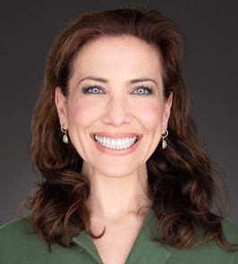
OASIS Update
Daniella Traveau
President, OASIS

Slide 11
ISO Path
1. Approval as an OASIS Standard (Completed)
2. Request to Submit to ISO/IEC JTC 1 (Completed)
3. Preparation of Submission Package and Explanatory Report
4. Submission and JTC 1 Review Process
5. Handling of Comments and Final Approval

Slide 12
NTAC Update
ONTOLOGIES: NTAC is exploring BFO/CCO–NIEM value and use cases
  The goal is to highlight the business value of using BFO and CCO in conjunction with NIEM
  Outputs include demonstrating potential use cases and opportunities, e.g.:
    Inter-agency (e.g. between DHS and DOD), or cross-domain (e.g. Justice and Health) collaboration
    Ontologies for inference in NIEM-enabled environments,
    and potential NIEM domain expansion, if domain ontologies provide new insight or opportunity.
TOOLING: NTAC Tooling Tiger Team discussion and recommendations
  Tooling Tiger Team has recommended expanded support for new developer tools (e.g., MCP server, broader support for Semantics, CMF SQL outputs, and various other tool improvements)
  We discussed the importance of user workflow(s), mapping templates, and accommodating new user personae - especially those who expect AI or ontologies to help them use NIEM more easily
  Pending: dependent upon successful completion of the API 2.0 and revised Training and Workflows
USER SURVEY: IJIS survey of NIEM practitioners currently in development

Slide 13
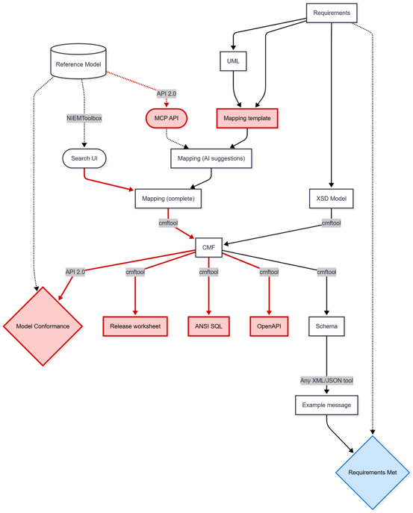
NIEMOpen Tools
Recommendations
Standardized mapping templates
  Message specifications
  Releases/domain updates, and other aspects of NBAC support
CMFTool enhancements
  Document how to use (In progress)
  Test XML/JSON/RDF interoperability (In progress)
  Import message mappings (Planned)
  Export ANSI SQL, OpenAPI and release worksheet (TBD)
API 2.0/NIEMToolbox enhancements
  Save mappings in Search UI
  Expose a Model Context Protocol (MCP) API
    (to enable third party AI tools)
  Validate Model Conformance of a CMF

Slide 14
Other NTAC initiatives on behalf of the PGB
DAMA-DMBOK 3.0 workshops
  DAMA is planning an expansion of DMBOK, and we hope this will include mention of NIEM
  NTAC co-chair planned to attend May/June workshops
NTAC preliminary conversations
  Anticipating NTAC support of the ISO certification process, hoping to discuss in June 2026
  Discussing website updates, including but not limited to SSGT, expanded Success Stories, and a streamlined communication of NIEM’s value to Government and Commercial users
Collaboration and Integration with Other Models
  Need for NIEM to work alongside other semantic reference models (e.g., BFO/CCO, HL7, CFACT)
  Emphasis on building partnerships rather than competition with other models (i.e. “Mapping vs Modeling”)
International Collaboration and Standards:
  Engagement with international bodies (e.g., NATO) to promote NIEM and its standards
  Interest in leveraging NIEM for global data management frameworks (DAMA, DPROD, DCAT, or data provenance standards)

Slide 15
Software engineering update
Added subset support (search and saving) to the NIEM Toolbox
Drafted wantlist 3.0 for the JSON format
The API has been updated to use the latest versions of CMF
and the CMF tool
NIEM Toolbox has been updated to use the new API
Updated and improved directory handling in github and website

Slide 16
NBAC update
June 18, 2026
Co-Chairs:
Kamran Atri Thomas Krul Paul Wormeli
Notes:
Welcome – Introduction.

Slide 17

NIEMOpen is:
An open source framework
for building a consensus on
data standards that facilitate
information sharing
across domains
and internationally

Slide 18






UNCLASSIFIED
Forensics Sub-Committee
Status Update
05.22.2026
UNCLASSIFIED

Slide 19
History & Progress
COMPLETED ACTIVITIES
Forensics Domain formally established in Spring 2025
Subcommittee Kick-Off Town Hall held in December 2025
Publication of an article in Journal of Forensics Research and a NIEMOpen press release
Forensics Subcommittee GitHub page for collaboration: https://github.com/niemopen/niem-forensics
Forensic attributes lists, rosters, and meeting documentation posted to GitHub
CURRENT ACTIVITIES
Tiger Teams
  Subcommittee leadership is conducting meetings with forensic organizations and subject matter experts to identify leads
  Tentative lead identified for Chemistry tiger team – awaiting confirmation
Subcommittee Documentation
  Draft SOP/Guidance document for tiger team leads under review
  GitHub page is being updated as new subcommittee documents are developed
UNCLASSIFIED

Slide 20
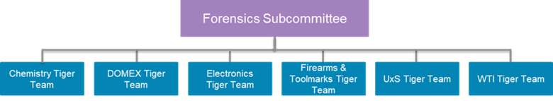
next steps
TIGER TEAM DEVELOPMENT
Timeframe: Ongoing
Process:
  Leadership will meet with tiger team leads as they are identified
  Leads will work with their tiger team to begin attribute refinement and development
GENERAL SUBCOMMITTEE MEETING
Timeframe: Fall 2026
Topics:
  Introduction of tiger team leads
  Status updates on tiger teams and attribute development
  Overview of GitHub page
UNCLASSIFIED

Slide 21
Update on Counter-UAS information standards
21
The emerging data standard for Counter‑UAS (C‑UAS) activities is being driven primarily by a U.S.–U.K. initiative to create a unified, interoperable data format for detection, tracking, and engagement of unmanned aerial threats. Purpose of the Standard:
Create common data formats for C‑UAS sensors, effectors, and command‑and‑control systems to transmit their findings
Improve sensor fusion, allowing multiple radars, RF detectors, EO/IR cameras, and effectors to share a unified picture
Enable interoperability between U.S. and U.K. systems, with potential expansion to NATO partners.
Reduce and enhance the C2 operator workload for interpreting and engaging UAS threat contacts
What Counter UAS data and information sharing standards have been developed so far?
NATO is in the process of adopting the UK-Developed SAPIENT (Sensing for Asset Protection with Integrated Electronic Networked Technology) approach
  SAPIENT Plug and Play approach is to enhance vendor products in order to process raw data and transmit standardized information exchange messages between components
  Utilize AI for processing and interpreting raw data for detecting, identifying and confirming UAS contacts
  Demonstrated and tested Counter UAS systems that integrated SAPIENT plug-and-play software engine
  UK MOD has developed an Interface Control Document (ICD) for SAPIENT integration
DOD and DHS have decided to adopt the NATO approach to maintain uniformity and key alignments with other countries implementing Counter UAS strategy. This includes:
  Open Architecture and interoperability
  AI and autonomous functionality
  Operational efficiency
  Plug-and-Play Implementation strategy with hardware vendors (NATO and US Army)
Notes:
Implementation strategies to date
Ukraine has not tested or integrated NATO approach but continues to rely on operator interpretation of raw data
NATO is still finalizing adoption of C-UAS standard (STANAG 4315) with partner countries
US Army is implementing the UK-DoD approach at the Corp unit level for C-UAS vendor purchases
DHS has separate implementation approach with Federal partners and States Grant money for States to implement C-UAS solutions is in 2026 and 2027 budget

Slide 22
Potential financial integrity domain
22
Support for information exchanges to counter fraud, waste and abuse
Scope could include contracts, grant management, beneficial ownership
Reuse of community-agreed data models, with local extensions
A technology-neutral data modeling language compatible with ontology formalisms
Knowledge graph representation of exchanged data
Automated conversion between supported serializations (XML to JSON, etc.)
Machine validation of message specifications for NIEM conformance
Machine validation of exchanged data for message specification conformance
Notes:
Another point to highlight is that you may be using NIEMOpen and not even know it.
NIEMOpen has been incorporated and leveraged by several other industry standards as identified on this slide. If you are currently using any of these standards, you are technically using NIEMOpen as well.

Slide 23
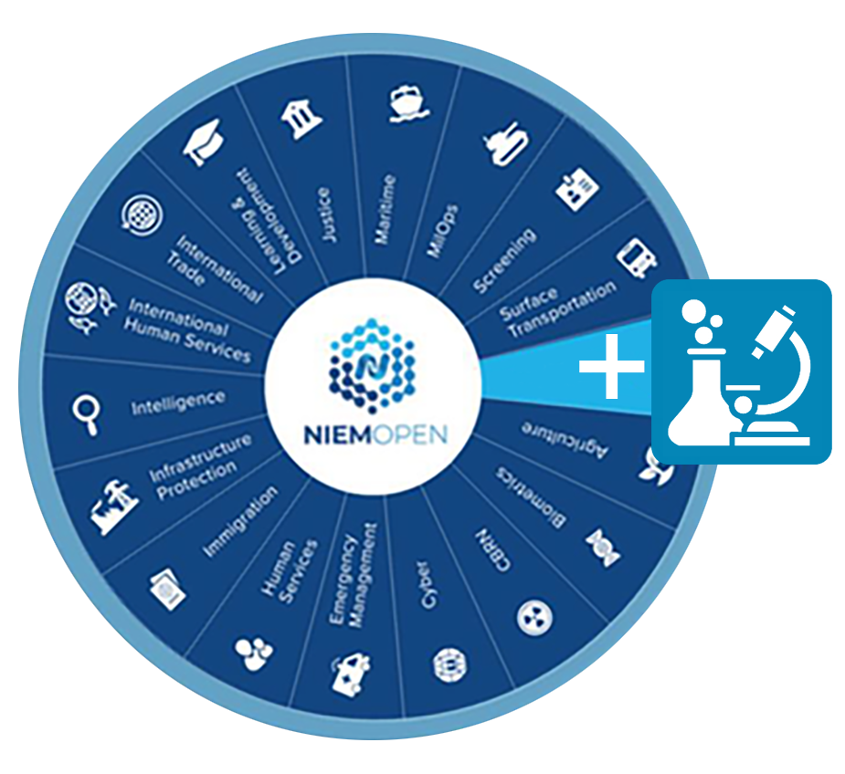
Situation
Domain engagement in Business Architecture meetings is low
  While attendance is typically acceptable, not all are represented
  Not enough engagement: questions, insight, ideas
Some Domains are dormant
  Original SMEs have achieved their goal (“maturity model”)
  Domain Leads have moved on
New domains need engagement
  Are we reaching the widest audience?
  Are we depending on too little people to do too much?
The more engagement, the better
Notes:
The NIEMOpen Forensics Subcommittee promotes interoperability across forensic organizations by providing the data elements needed to facilitate the exchange of crucial forensics information.

Slide 24
Proposal:
Domain-specific NIEMOPEN Business Architecture meetings
1. A Domain is selected months in advance
2. Reach-out
All members are asked to spread word-of-mouth to SMEs or stakeholders Kevin Bacon-style
NIEMOPEN and Leads will search for and contact SMEs or stakeholders
  Government Directories
  LinkedIN
  Google
We will include private sector, all branches of national and international
3. Meeting is held
Intro, short order of NIEMOPEN business, then focused solely on the specific Domain
Notes:
The NIEMOpen Forensics Subcommittee promotes interoperability across forensic organizations by providing the data elements needed to facilitate the exchange of crucial forensics information.

Slide 25

CY 2025 Q3 FINANCIALS
Ms. Cathie Mayo – OASIS Chief Financial Officer

Slide 26
CY/FY 2026 Q2 FINANCIALS
Summary:
FY 2025 Balance Forward | $159,519
FY 2026 Funding | 20,000
FY Total funds Available YTD | 179,518
Expenditures 2026 YTD | 28,702
Current Obligations | 72,432
Ending Balance 2026-Q2 | 150,816

Slide 27
2026 Initiatives
June 18, 2026

Slide 28
Initiatives
DMBOK
Community Survey
Sponsor/Volunteer Recruitment

Slide 29
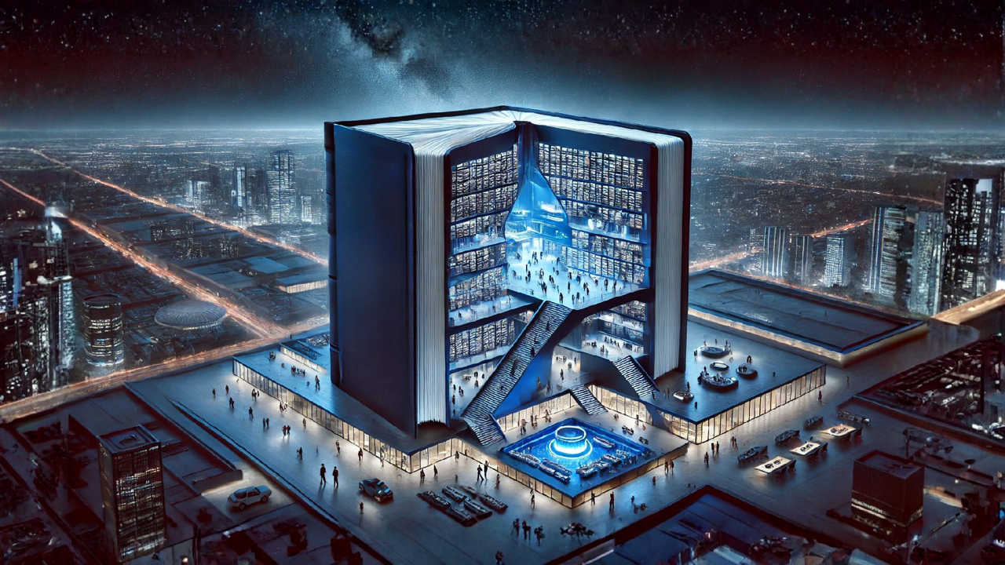





DAMA-DMBOK®
DATA MANAGEMENT BODY OF KNOWLEDGE
PHYSICAL BOOK
DIGITAL CONTENT MANAGEMENT SYSTEM

Slide 30
DAMA-DMBOK® 3.0
In Print
On-line
Training
Certification

Slide 31
NIEMOpen Community Survey
Use, Requirements, Satisfaction
Survey design committee
Survey and analysis by IJIS
PGB Briefing

Slide 32
BOARD PRESENTATION | 2026
Building a Sustainable Future
A Campaign to Recruit Sponsors & Volunteers for NiEMOpen
Growing Need
Community Power
12-Month Plan
Expanding user base
requires sustained support
Volunteers & sponsors
drive open-source success
Structured campaign
with clear milestones
1

Slide 33
THE CASE FOR ACTION
Why We Need This Campaign
⚠
Resource Constraints
📈
Accelerating Demand
NiEMOpen relies on a limited pool of volunteers and lacks dedicated funding, creating bottlenecks in development, testing, and release cycles.
Adoption of NiEMOpen is growing across government agencies and industry. Without matching resource growth, quality and responsiveness will decline.
🏛
Long-Term Governance
🤝
Community Expectations
Formal sponsor relationships ensure continuity of leadership and resources beyond individual volunteers, providing institutional stability.
Stakeholders and users expect a roadmap with predictable delivery. A funded, volunteer-rich program signals commitment and professionalism.
2

Slide 34
HIGH-LEVEL STRUCTURE
Campaign Components
💰 SPONSOR TRACK
🤝 VOLUNTEER TRACK
▸ Tier Structure
▸ Role Definition
Define Bronze / Silver / Gold tiers with clear benefits, recognition, and contribution levels.
Map required volunteer roles — developers, reviewers, educators, governance leads — with time commitments.
▸ Prospect Outreach
▸ Recruitment Channels
Identify and engage government agencies, standards bodies, and technology vendors aligned with NIEM.
Partner with universities, professional associations, and existing NIEM stakeholders for outreach.
▸ Value Proposition Kits
▸ Onboarding Program
Develop tailored materials articulating ROI for each sponsor category.
Create structured onboarding documentation, mentorship pairings, and contribution toolkits.
▸ Stewardship & Reporting
▸ Recognition & Retention
Establish quarterly sponsor briefings and transparent fund-usage reporting.
Launch contributor badges, annual recognition events, and career-development incentives.
3

Slide 35
12-MONTH EXECUTION PLAN
Campaign Timeline
Q1
Q2
Q3
Q4
Foundation
Launch
Activation
Consolidation
Board approval
Campaign team formed
Branding & materials
Sponsor outreach begins
Volunteer recruitment
Website & portal live
First sponsors confirmed
Onboarding cohort #1
Progress reporting
Annual review
Tier 2 outreach
Roadmap for Year 2
4

Slide 36








NIEMOpen Current Sponsors
8 Sponsors, 2 Premier
Sponsors
Bright Query
DHS S&T
CJIS (FBI)
GTRI
NAJIS
IJIS
Senzing
SEARCH
Premier
Premier
Potential Sponsors
Federal agencies
State and local agencies
Private Sector
Non-governmental agencies
International agencies

Slide 37


PGB MEMBERS: AROUND-THE-HORN

Slide 38
PGB Meeting Schedule 2026
NEXT PGB Meeting
Thursday, September 17, 2026
Virtual Meeting 2 – 4 PM EST
  Virtual: ZOOM
CY 2026 Meeting Dates
Q1 | MAR 19 | 2 – 4 PM | EDT
Q2 | JUN 18 | 2 – 4 PM | EDT
Q3 | SEP 17 | 2 – 4 PM | EDT
Q4 | DEC 3 | 2 – 4 PM | EST

Slide 39

Real-World Success Factors
Structure
Commitment
Participation
Collaborative and transparent governance committees
Become a sponsor
Allocate time to serve
Conform to standards
Join relevant committees
Attend meetings
Make contributions

Slide 40



